Slide 1
Generating noisy speech data from clean data in the frequency domain using Deep Learning Methods
Week – 3
Name: Shashank Shirol
University: Manipal Institute of Technology
Duration of the presentation: ~10 mins.

Slide 2
Tasks to be completed:
Train SinGAN to see if it learns voice characteristics from the training sample.
Train SinGAN with Donald Trump’s voice and see whether generation learns Donald Trump’s voice;
Combinations:
Training: Trump – 8k Paint: Male clean – 8k (different content)
Training: Trump – 16k Paint: Male clean – 8k (different content)
Training: Trump – 8k Paint: Homer Simpson – 8k (same content)
Add Digital noise to spectrograms and train SinGAN on them, check whether SinGAN successfully introduces such noise in paint samples.
Different Noises Tested:
Salt and Pepper
Gaussian
Speckle
Poisson
Try training SinGAN with RATs Noisy data, and check whether it learns to introduce similar noise in the outputs.
Try Clipping the input training audio (to add distortion) before passing through codecs and training SinGAN.
Document Time required for scale training, generation and reconstruction.

Slide 3
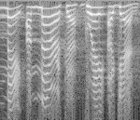

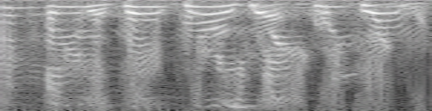
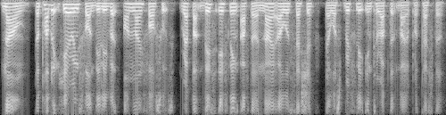
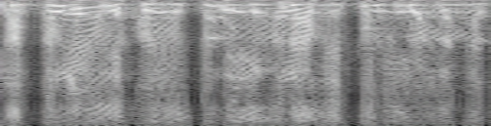
Trying to see if SinGAN learns voice characteristics (I):
Training Image: Donald Trump (8k) Paint Image: Clean Male Spec (8k) Content: Different
Observation: Did not learn voice characteristics. Maybe need longer training audio.
Training Audio:
Scale 1
Paint Audio:
Scale 4

Slide 4
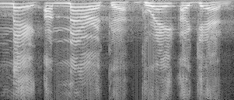
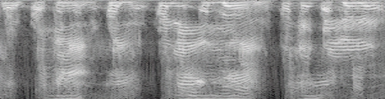
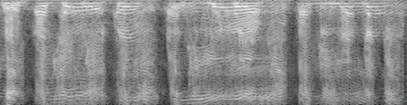
Trying to see if SinGAN learns voice characteristics (II):
Training Image: Donald Trump (16k) Paint Image: Clean Male Spec (8k) Content: Different
Observation: Did not learn voice characteristics but got discernible outputs early. Why?
Training Audio:
Scale 1
Paint Audio:
Scale 2

Slide 5
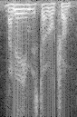

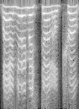
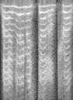
Trying to see if SinGAN learns voice characteristics (III):
Training Image: Donald Trump (8k) Paint Image: Homer Simpson (8k) Content: Different
Observation: Did not learn voice characteristics but got discernible outputs early. Got observable outputs immediately (from scale 1). Outputs start taking shape of paint image.
Training Audio:
Scale 1
Paint Audio:
Scale 6

Slide 6
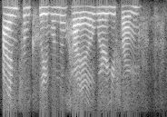
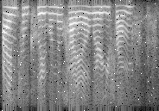
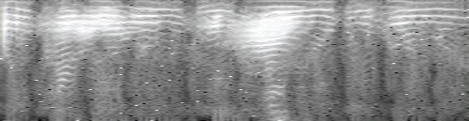
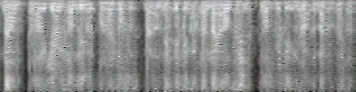
Trying to see if SinGAN learns digitally added noise (I):
Training Image: Female clean + Salt and Pepper noise (8k) Paint Image: Male Clean(8k) Content: Different
Observation: SinGAN successfully learns to introduce S&P noise in the output. It is seen that outputs from scale 1 have the salt and pepper noise, but we get observable output from scale 5.
Clean Spec of training audio.
Training Audio:
Scale 1
Paint Audio:
Scale 5

Slide 7


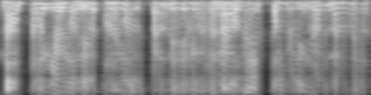
Trying to see if SinGAN learns digitally added noise (II):
Training Image: Female clean + Gaussian noise (8k) Paint Image: Male Clean(8k) Content: Different
Observation: SinGAN successfully learns to introduce Gaussian noise in the output. A trend seen in previous manually added noise and it follows for other noises that follow.
Clean Spec of training audio.
Training Audio:
Scale 1
Paint Audio:
Scale 5

Slide 8
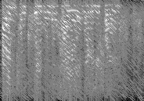

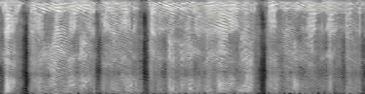
Trying to see if SinGAN learns digitally added noise (III):
Training Image: Female clean + Speckle noise (8k) Paint Image: Male Clean(8k) Content: Different
Observation: Similar to what we’ve seen in the previous two cases. SinGAN learns to introduce the speckle noise to the outputs.
Clean Spec of training audio.
Training Audio:
Scale 1
Paint Audio:
Scale 5

Slide 9
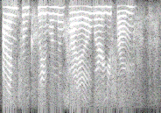

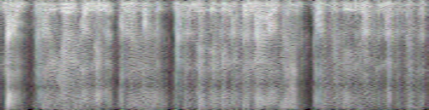
Trying to see if SinGAN learns digitally added noise (III):
Training Image: Female clean + Poisson noise (8k) Paint Image: Male Clean (8k) Content: Different
Observation: SinGAN learns to introduce the Poisson noise to the outputs.
Clean Spec of training audio.
Training Audio:
Scale 1
Paint Audio:
Scale 5

Slide 10
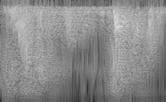
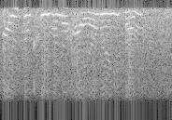
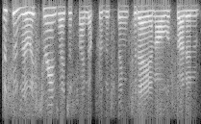
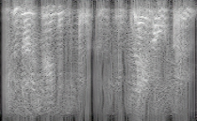
Trying to see if SinGAN learns RATs Noise:
Training Image: Female noisy(8k) Paint Image: Female Clean(8k) Content: Different
Observation: The outputs sound somewhat similar. Scale 3 output and the ground truth sound similar.
RATs Ground Truth
Training Audio:
Scale 1
Paint Audio:
Scale 3

Slide 11
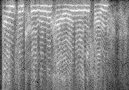
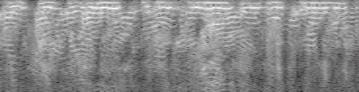
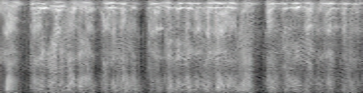
Trying to see if SinGAN learns to distort audio, if trained on clipped noisy audio:
Training Image: Female noisy(95% clipped + amr475) Paint Image: Male Clean(8k) Content: Different
Observation: The outputs sound somewhat similar. Scale 3 output and the ground truth sound similar.
Training Audio:
Scale 1
Paint Audio:
Scale 4

Slide 12
Training and Generation times:
Training times a 8 scaled SinGAN Model
Generation times for a 8-scale SinGAN:
Dimensions of Train_image = 184x129 (a 2 sec audio)
Dimensions of Paint_image = 500x129 (a 8 sec audio)
Spec Generation Time at:
scale 1: 0.75s ± 0.03s
scale 2: 0.73s ± 0.03s
scale 3: 0.72s ± 0.03s
scale 4: 0.72s ± 0.03s
scale 5: 0.71s ± 0.03s
scale 6: 0.71s ± 0.03s
scale 7: 0.68s ± 0.03s
Observation: Generation at different scale almost takes the same time.
Reconstruction time: (for a 8 sec audio)
0.015s ± 0.002s
Scale 0: start: 4.02s end: 381.47s total_time: 377.45s | Scale 1: start: 381.54s end: 787.98s total_time: 406.44s
Scale 2: start: 788.05s end: 1229.42s total_time: 441.36s | Scale 3: start: 1229.50s end: 1685.94 total_time: 456.43s
Scale 4: start: 1685.99s end: 2155.15s total_time: 469.16s | Scale 5: start: 2155.24s end: 2668.64s total_time: 513.40s
Scale 6: start: 2668.74s end: 3487.63s total_time: 818.89s | Scale 7: start: 3487.74s end: 5438.86s total_time: 1951.12s
Observation: Lower scales are trained in less time as compared to higher scales. This is because of the difference in the effective patch size at different scales.

Slide 13
End.

